Slide 1

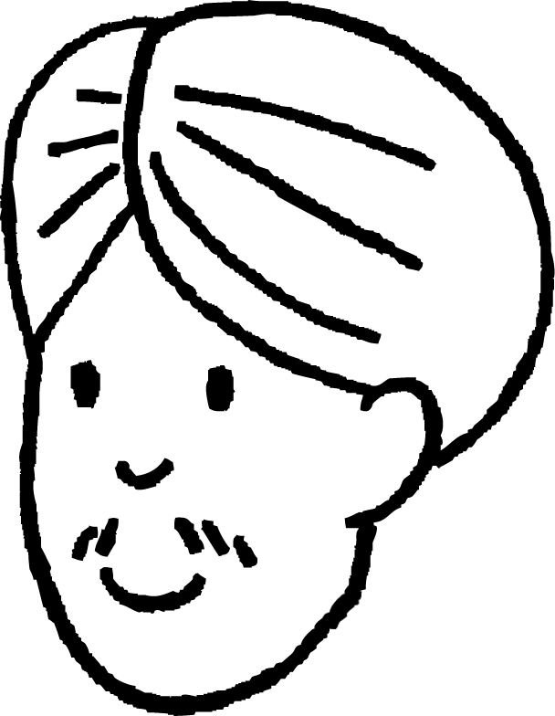
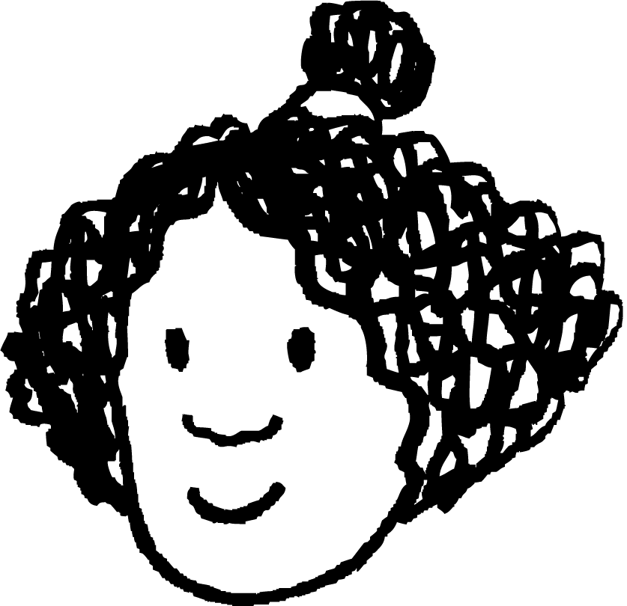







Checking understanding of sequences
Task A: Sequences with a constant additive pattern
These pupils are making number patterns from a rule
Aisha says any number, Andeep adds a number to it. Each pupil then adds the same number Andeep added. For each question, justify your answer.
If Aisha says 6 and Andeep says 10, what will Izzy say?
If Aisha says 6 and Andeep says 10, what will Sofia say?
Aisha
Andeep
Izzy
Jacob
Jun
Lucas
Laura
Sam
Alex
Sofia
After a different starting number Sam says 17 and Alex says 19. What did Aisha say?
If Aisha says 4 to start and Jun says 40 What will Lucas say?
Aisha starts with 10, only Lucas’ number is another integer, what could Andeep have said?

Slide 2

Checking understanding of sequences
Task B: Sequences with a constant multiplicative pattern
Sort these sequences into the correct column
Sequences with a constant additive relationship | Sequences with a constant multiplicative relationship
5, 10, 15, 20, …
5.7, 8.1, 10.5, 12.9, …
3, -6, 12, -24 …
1, 2, 4, 8, …
48, 24, 12, 6, …
6, 48, 90, 132, …
3, 30, 300, 3000, …
1.5, 0.5, -0.5, -1.5, …
0.5, 1.5, 4.5, 13.5, …
2) Find the missing numbers in these sequences with constant multiplicative patterns.
6, 12, 24, , …
5, 30, , 1080, …
160, 80, 40, , …
0.3, -3, 30, , …
e) , 21, 63, 189, …
f) 1, 0.2, 0.04, , …
g) 0.4, 8, 160, ,64 000, …
h) , 6, 8, , …
Mathematics in Education and Industry
v2.1

